Slide 1
Boolean retrieval

Slide 2
Term-document incidence matrices
Sec. 1.1
1 if play contains word, 0 otherwise
Brutus AND Caesar BUT NOT Calpurnia
Notes:
Antony and Cleopatran.安东尼与克里奥佩特拉
Julius Caesar 尤利乌斯•凯撒
The Tempest 暴风雨
《安东尼与克莉奥佩特拉》是莎士比亚于1607年左右编写的罗马悲剧，它是源于古罗马历史学家普鲁塔克的《希腊罗马名人传》。
戏剧讲述的是当时罗马的三大首领之一：安东尼因沉迷于埃及女王克莉奥佩特拉的美色而无暇于国家大事，终日与她在埃及厮混，天天醉生梦死。后来，罗马受到塞克斯特斯·庞贝的叛乱，海盗的入侵，东方帕提亚人的人侵以及安东尼妻子因向凯撒挑战失败而死的消息终于让他重新振作起来，毅然回到罗马，为祖国效力。安东尼遂因形势需要与屋大维和好，并娶其妹来巩固彼此的政治关系。这也让克莉奥佩特拉又伤心又愤怒。终于，各种战事和解消停后，安东尼迫不及待的回到了埃及女王身边。后来庞贝被杀，同僚莱皮德斯被废黜导致了最后安东尼和屋大维的两虎对峙。在海上对战中，安东尼不明智地跟随埃及女王逃跑而战败，最终伤心自刎，克莉奥佩特拉也终于看清屋大维的真面目，自杀身亡。

Slide 3
Inverted index
Sec. 1.2
For each term t, we must store a list of all documents that contain t.
Identify each doc by a docID, a document serial number
Can we used fixed-size arrays for this?
Brutus
1
2
4
11
31
45
173
174
Caesar
1
2
4
5
6
16
57
132
Calpurnia
2
31
54
101
What happens if the word Caesar is added to document 14?

Slide 4
Inverted index
Sec. 1.2
We need variable-size postings lists
On disk, a continuous run of postings is normal and best
In memory, can use linked lists or variable length arrays
Some tradeoffs in size/ease of insertion
Posting
Brutus
1
2
4
11
31
45
173
174
Caesar
1
2
4
5
6
16
57
132
Calpurnia
2
31
54
101
Dictionary
Postings
Sorted by docID (more later on why).
Notes:
Linked lists generally preferred to arrays
Dynamic space allocation
Insertion of terms into documents easy
Space overhead of pointers

Slide 5
Query processing: AND
Sec. 1.3
Consider processing the query:
Brutus AND Caesar
Locate Brutus in the Dictionary;
Retrieve its postings.
Locate Caesar in the Dictionary;
Retrieve its postings.
“Merge” the two postings (intersect the document sets):
2
4
8
16
32
64
128
Brutus
1
2
3
5
8
13
21
34
Caesar

Slide 6
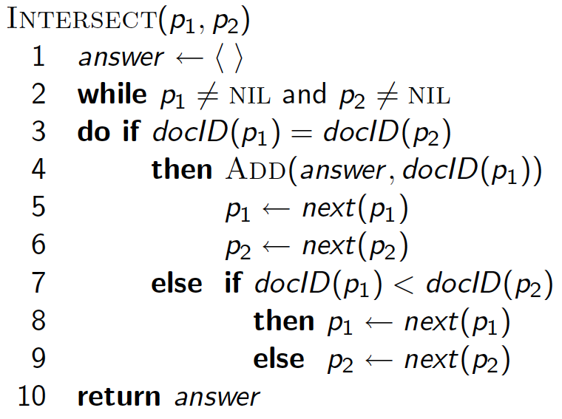
Intersecting two postings lists (a “merge” algorithm)

Slide 7
Tolerant retrieval

Slide 8
Wild-card queries: *
Sec. 3.2
mon*: find all docs containing any word beginning with “mon”.
Easy with binary tree (or B-tree) lexicon: retrieve all words in range: mon ≤ w < moo
*mon: find words ending in “mon”: harder
Maintain an additional B-tree for terms backwards.
Can retrieve all words in range: nom ≤ w < non.
Exercise: from this, how can we enumerate all terms
meeting the wild-card query pro*cent ?
Notes:
Wild card 外卡; 通配符; 未知数

Slide 9
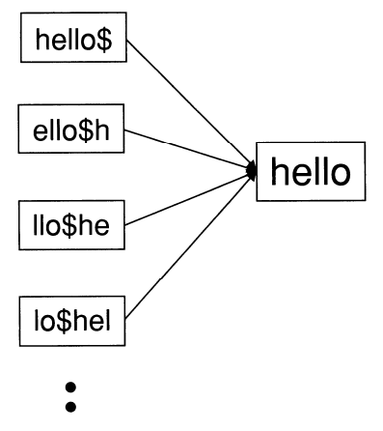
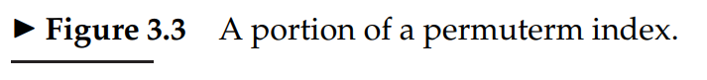
Permuterm index
Sec. 3.2.1
For term hello, index under:
hello$, ello$h, llo$he, lo$hel, o$hell, $hello
where $ is a special symbol.
Queries:
*X lookup on X$*
X*Y lookup on Y$X*
Query = hel*o
X=hel, Y=o
Lookup o$hel*
Notes:
Permuterm (Permuted term) 轮排

Slide 10
MapReduce

Slide 11
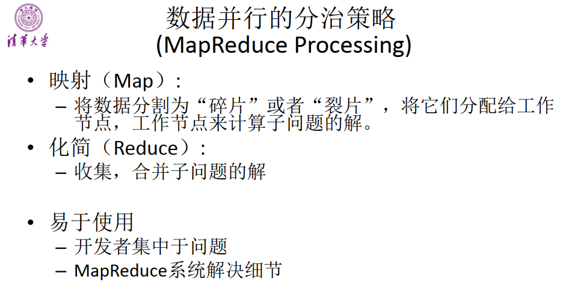

Slide 12
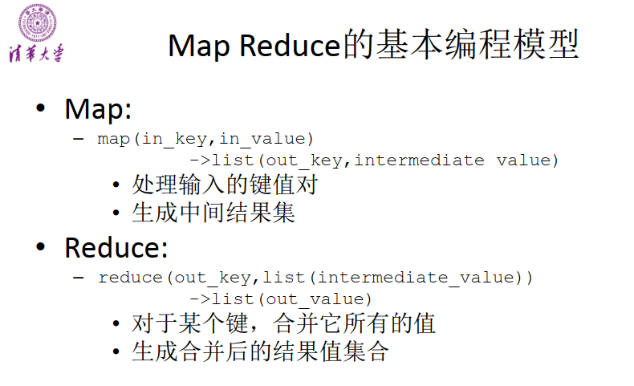

Slide 13
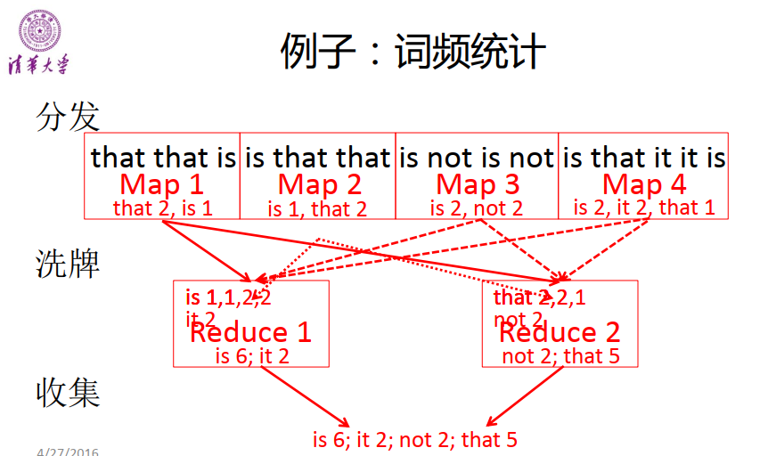

Slide 14
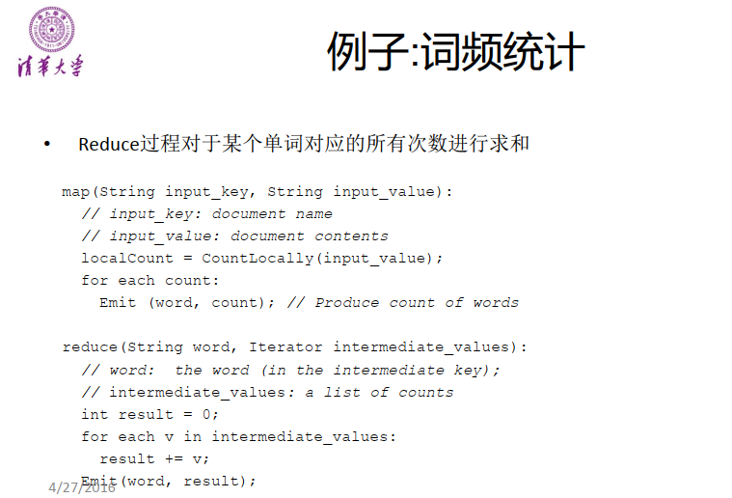

Slide 15
MapReduce
map
reduce
(k1,v1)
(k2,list(v2))
➔ list(k2,v2)
➔ list(v3)
输入的键和值，与输出的键和值相比，属 于不同的区域
中间结果中的键和值，与输出的键和值相 比，属于相同的区域
19

Slide 16
Example: Host size
Suppose we have a large web corpus
Look at the metadata file
Lines of the form: (URL, size, date, …)
For each host, find the total number of bytes
That is, the sum of the page sizes for all URLs from that particular host
Map:
For each record, output (hostname(URL), size)
Reduce:
Sum the sizes for each host

Slide 17
Example: Language Model
Statistical machine translation:
Need to count number of times every 5-word sequence occurs in a large corpus of documents
Very easy with MapReduce:
Map:
Extract (5-word sequence, count) from document
Reduce:
Combine the counts

Slide 18
Schema for index construction in MapReduce
Sec. 4.4
Schema of map and reduce functions
map: input → list(k, v) reduce: (k,list(v)) → output
Instantiation of the schema for index construction
map: collection → list(termID, docID)
reduce: (<termID1, list(docID)>, <termID2, list(docID)>, …) → (postings list1, postings list2, …)
Notes:
instantiation英 [ɪnstænʃɪ'eɪʃən] 美 [ɪnstænʃɪ'eɪʃən] n.实例化，例示

Slide 19
Example for index construction
Map:
d1 : Caesar came, Caesar conquered.
d2 : Caesar died. →
< Caesar,d1>, <came,d1>, < Caesar,d1>, < conquered, d1>, < Caesar, d2>, <died,d2>
Reduce:
(< Caesar,(d1,d1,d2)>, <died,(d2)>, <came,(d1)>, < conquered,(d1)>) →
(< Caesar,(d1:2,d2:1)>, <died,(d2:1)>, <came,(d1:1)>, < conquered,(d1:1)>)

Slide 20
Scoring, term weighting and the vector space model

Slide 21
Bag-of-Words representation
Term as the basis for vector space
Doc1: Text mining is to identify useful information.
Doc2: Useful information is mined from text.
Doc3: Apple is delicious.
 | text | information | identify | mining | mined | is | useful | to | from | apple | delicious
Doc1 | 1 | 1 | 1 | 1 | 0 | 1 | 1 | 1 | 0 | 0 | 0
Doc2 | 1 | 1 | 0 | 0 | 1 | 1 | 1 | 0 | 1 | 0 | 0
Doc3 | 0 | 0 | 0 | 0 | 0 | 1 | 0 | 0 | 0 | 1 | 1

Slide 22
How to assign weights?
Important!
Why?
Corpus-wise: some terms carry more information about the document content
Document-wise: not all terms are equally important
How?
Two basic heuristics
TF (Term Frequency) = Within-doc-frequency
IDF (Inverse Document Frequency)

Slide 23
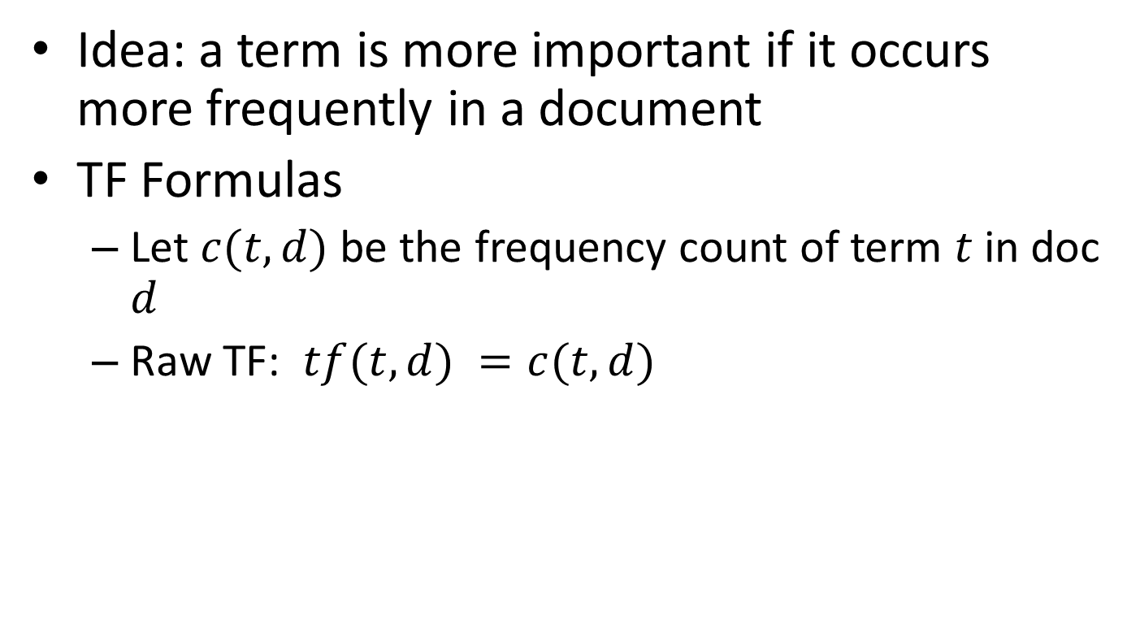
Term frequency
Idea: a term is more important if it occurs more frequently in a document
TF Formulas
Let $c(t,d)$ be the frequency count of term $t$ in doc $d$
Raw TF: $tf(t,d) =c(t,d)$

Slide 24
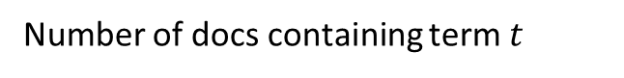
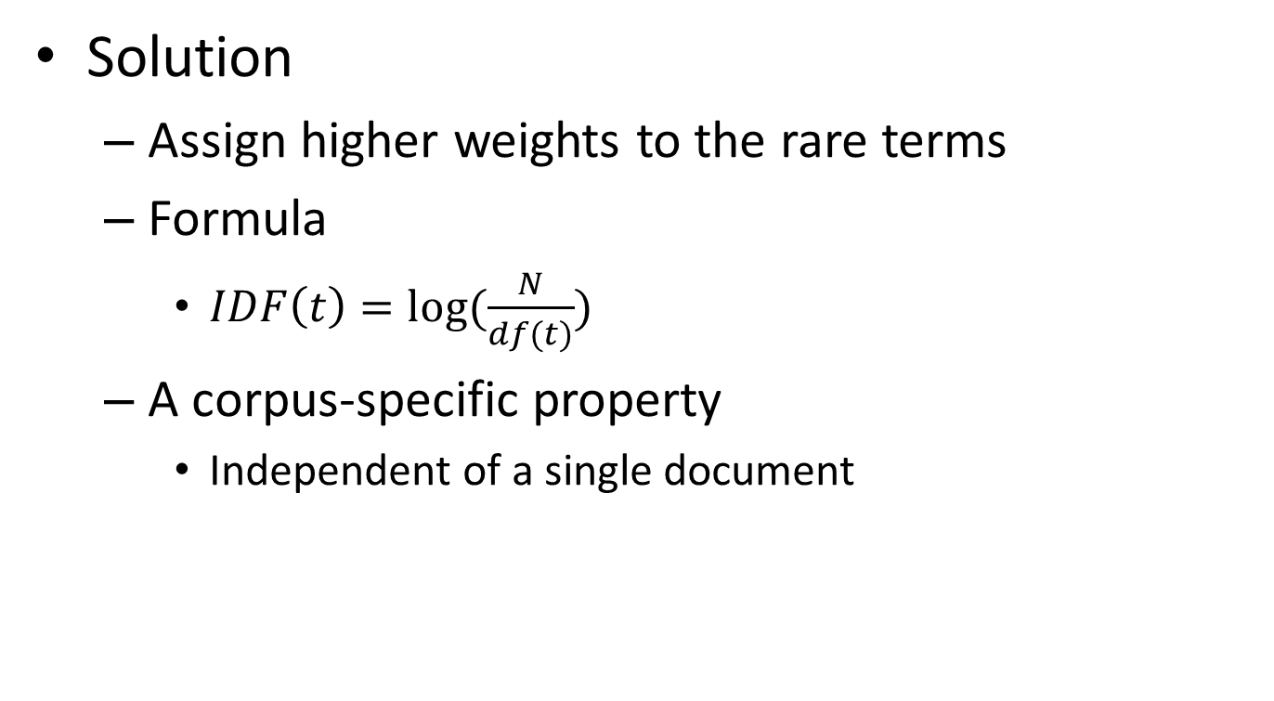
Inverse document frequency
Solution
Assign higher weights to the rare terms
Formula
$IDF\left(t\right)=log⁡(\frac{N}{df(t)})$
A corpus-specific property
Independent of a single document
Non-linear scaling
Total number of docs in collection
Number of docs containing term $t$

Slide 25
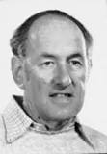
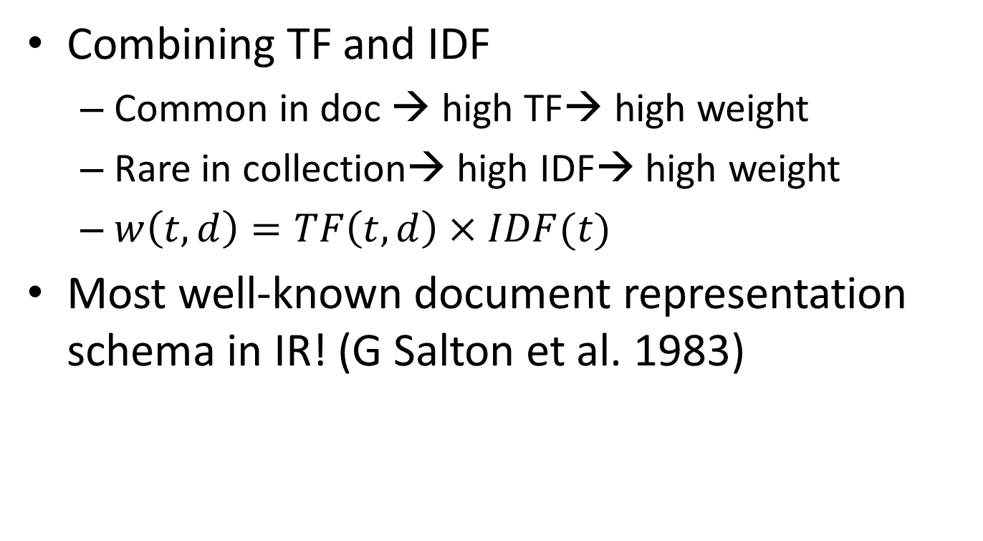
TF-IDF weighting
Combining TF and IDF
Common in doc → high TF→ high weight
Rare in collection→ high IDF→ high weight
$w\left(t,d\right)=TF\left(t,d\right)×IDF(t)$
Most well-known document representation schema in IR! (G Salton et al. 1983)
“Salton was perhaps the leading computer scientist working in the field of information retrieval during his time.” - wikipedia
Gerard Salton Award
– highest achievement award in IR

Slide 26
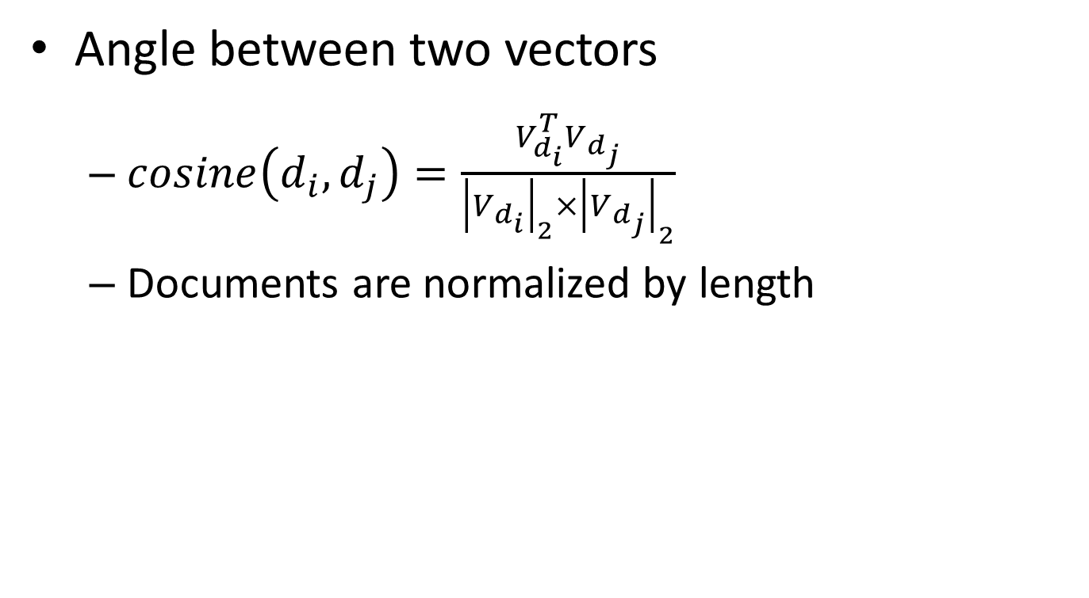
Cosine similarity
TF-IDF vector
Angle between two vectors
$cosine\left(d_{i},d_{j}\right)=\frac{V_{d_{i}}^{T}V_{d_{j}}}{{\left|V_{d_{i}}\right|}_{2}×{\left|V_{d_{j}}\right|}_{2}}$
Documents are normalized by length
Unit vector
Finance
D₂
TF-IDF space
D₁
D₆
Sports

Slide 27
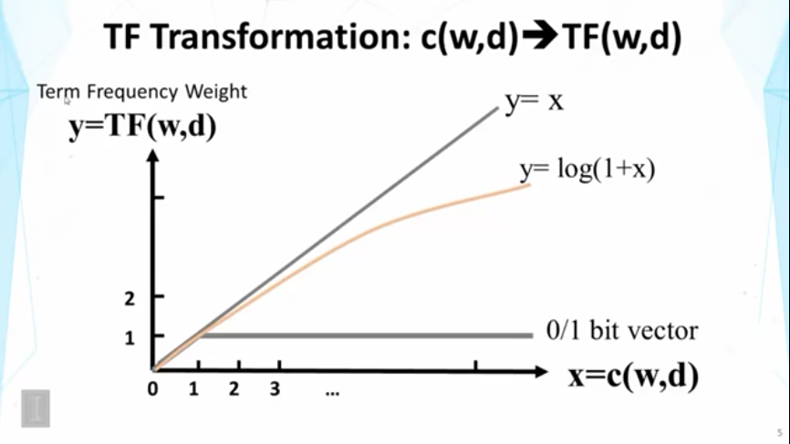

Slide 28
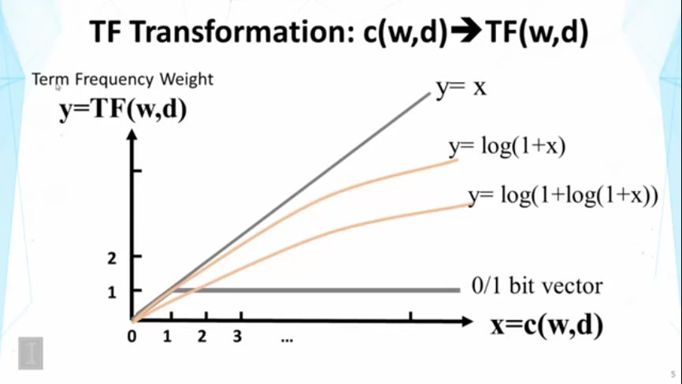

Slide 29
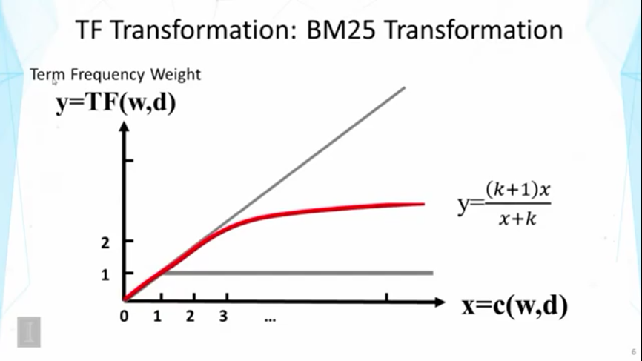

Slide 30
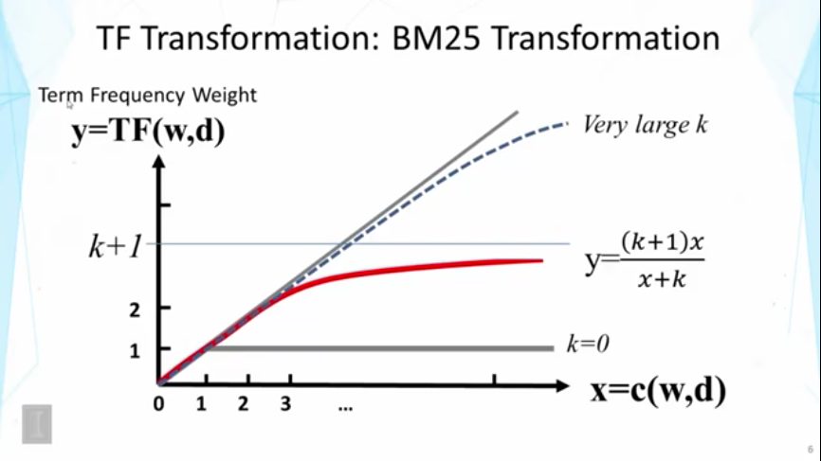

Slide 31
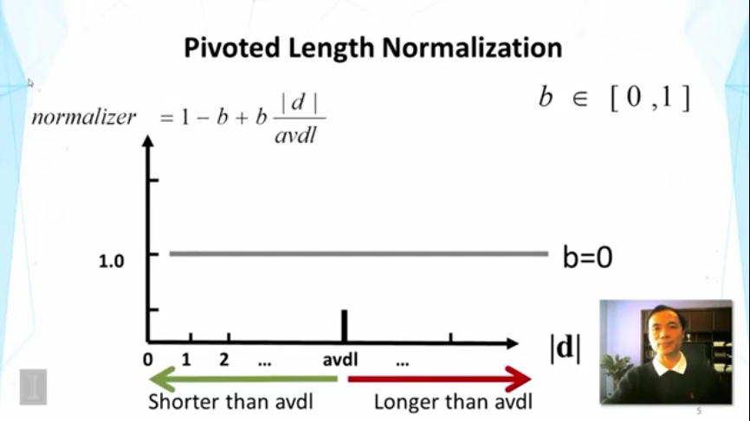

Slide 32
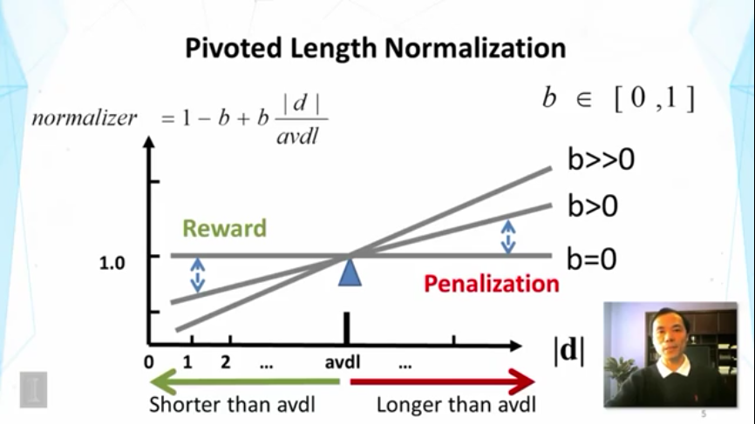

Slide 33
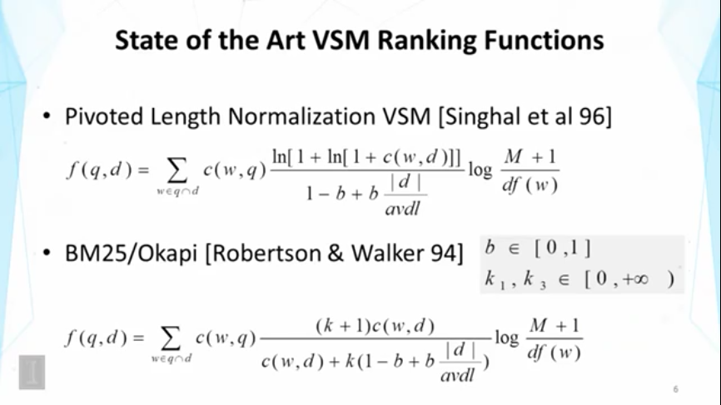

Slide 34
Evaluation

Slide 35
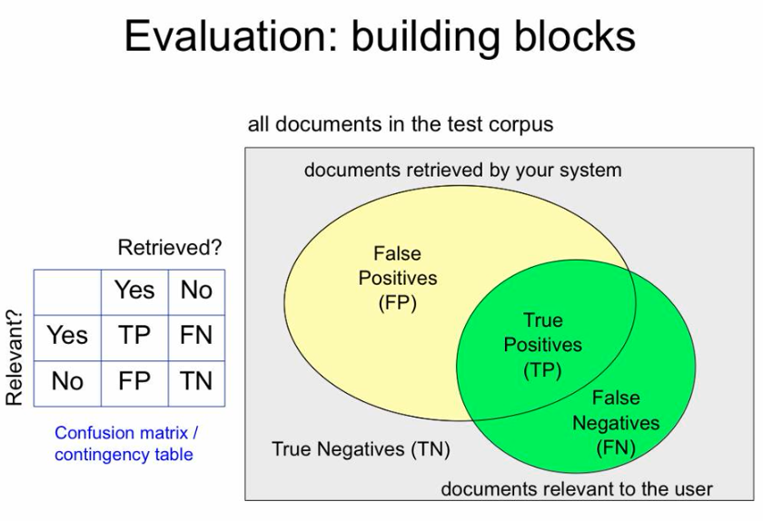

Slide 36
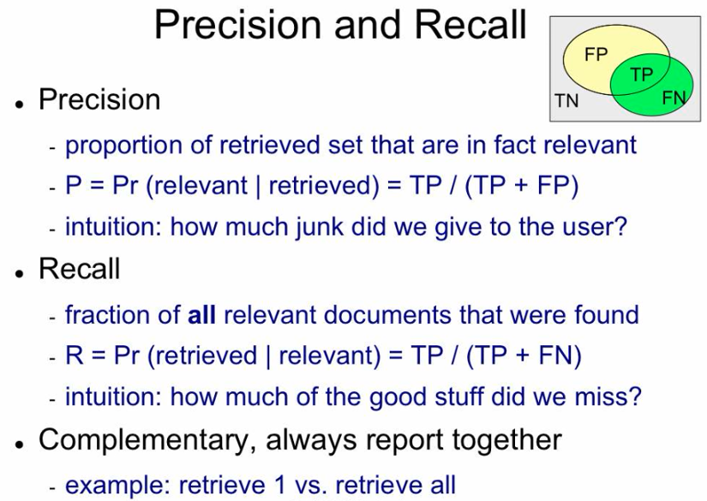

Slide 37
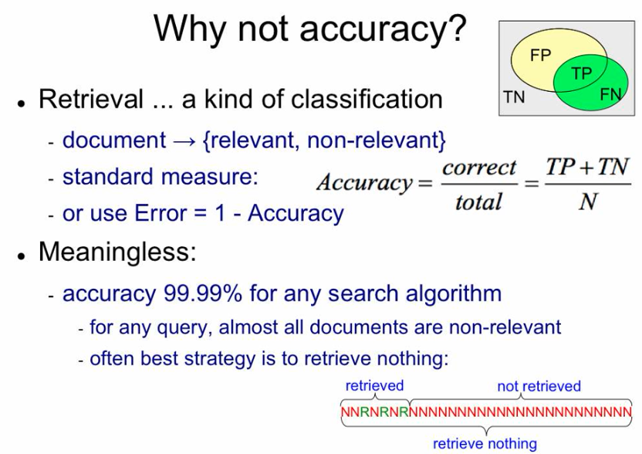

Slide 38
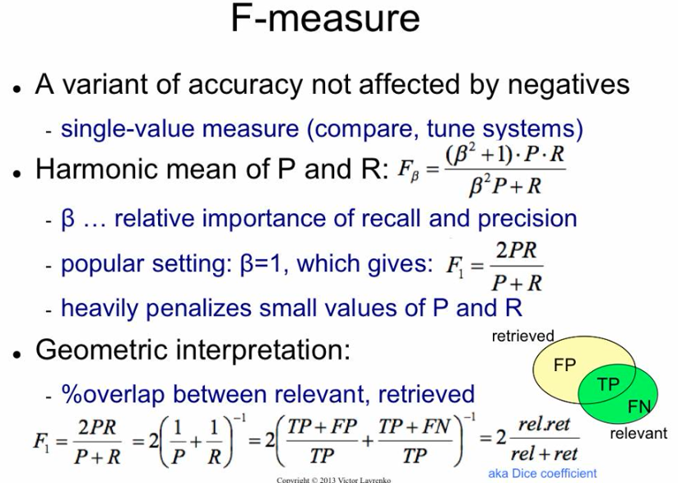

Slide 39

Precision@K
Set a rank threshold K
Compute % relevant in top K
Ignores documents ranked lower than K
Ex:
Prec@3 of 2/3
Prec@4 of 2/4
Prec@5 of 3/5
In similar fashion we have Recall@K

Slide 40
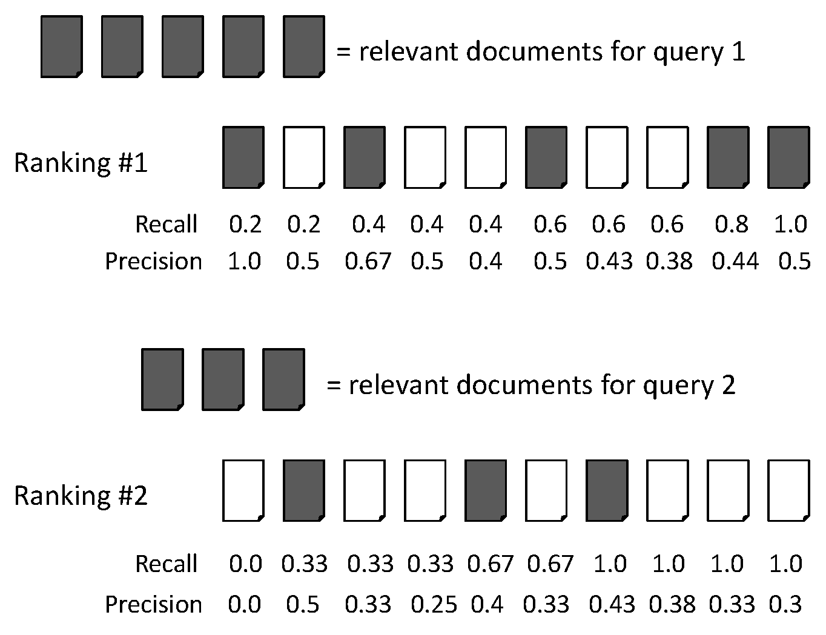
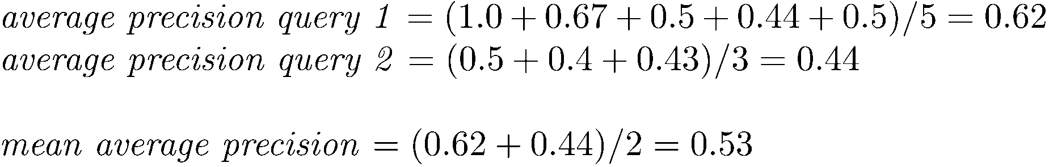
MAP

Slide 41
Summarize a Ranking: DCG
What if relevance judgments are in a scale of [0,r]? r>2
Cumulative Gain (CG) at rank n
Let the ratings of the n documents be r₁, r₂, …r_{n} (in ranked order)
CG = r₁+r₂+…r_{n}
Discounted Cumulative Gain (DCG) at rank n
DCG = r₁ + r₂/log₂2 + r₃/log₂3 + … r_{n}/log₂n
We may use any base for the logarithm
Notes:
For rank positions above b, do not discount

Slide 42
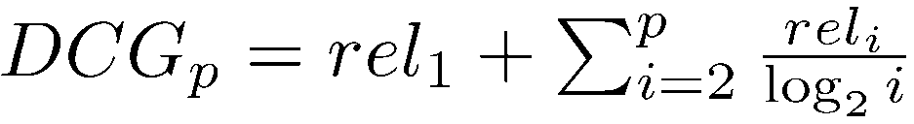
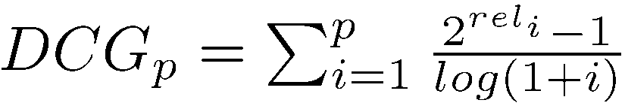
Summarize a Ranking: DCG
DCG is the total gain accumulated at a particular rank p:
Alternative formulation:
used by some web search companies
emphasis on retrieving highly relevant documents

Slide 43
Summarize a Ranking: NDCG
Normalized Discounted Cumulative Gain (NDCG) at rank n
Normalize DCG at rank n by the DCG value at rank n of the ideal ranking
The ideal ranking would first return the documents with the highest relevance level, then the next highest relevance level, etc
Normalization useful for contrasting queries with varying numbers of relevant results
NDCG is now quite popular in evaluating Web search
Notes:
Perfect ranking:
3, 3, 3, 2, 2, 2, 1, 0, 0, 0
ideal DCG values:
3, 6, 7.89, 8.89, 9.75, 10.52, 10.88, 10.88, 10.88, 10
Actual DCG:
3, 5, 6.89, 6.89, 6.89, 7.28, 7.99, 8.66, 9.61, 9.61
NDCG values (divide actual by ideal):
1, 0.83, 0.87, 0.76, 0.71, 0.69, 0.73, 0.8, 0.88, 0.88
NDCG ≤ 1 at any rank position

Slide 44
Mean Reciprocal Rank
Consider rank position, K, of first relevant doc
Could be – only clicked doc
Reciprocal Rank score =
MRR is the mean RR across multiple queries

Slide 45
Probabilistic Models for Information Retrieval

Slide 46
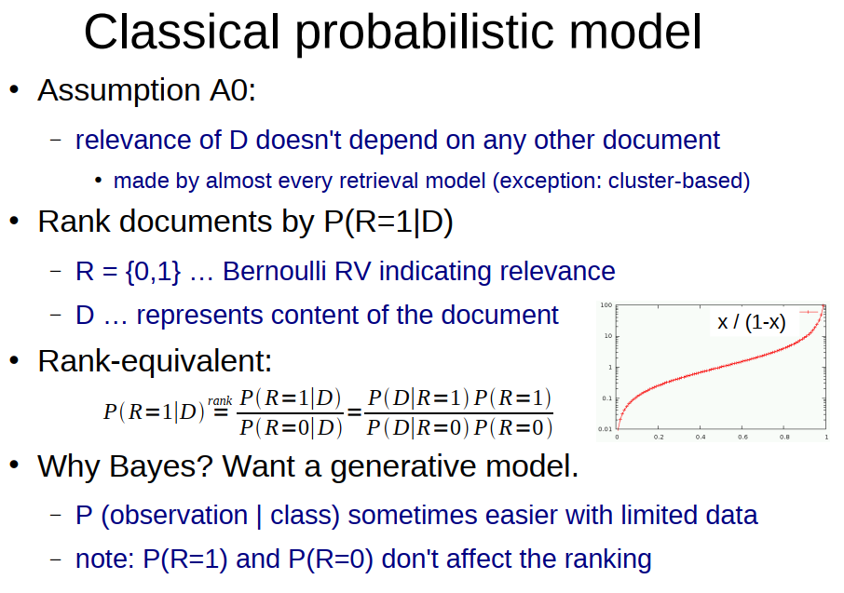

Slide 47
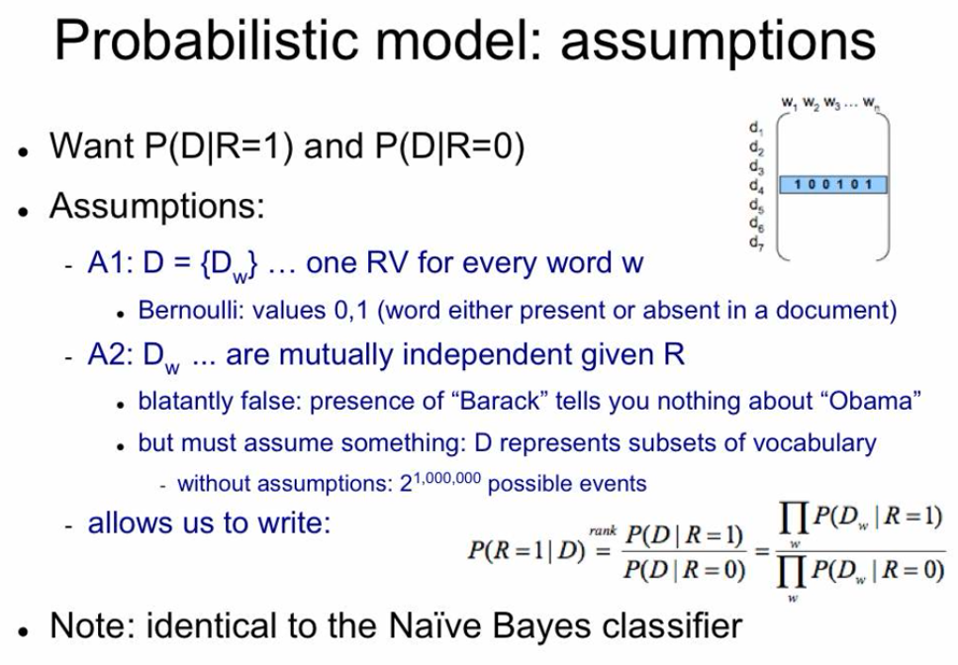

Slide 48
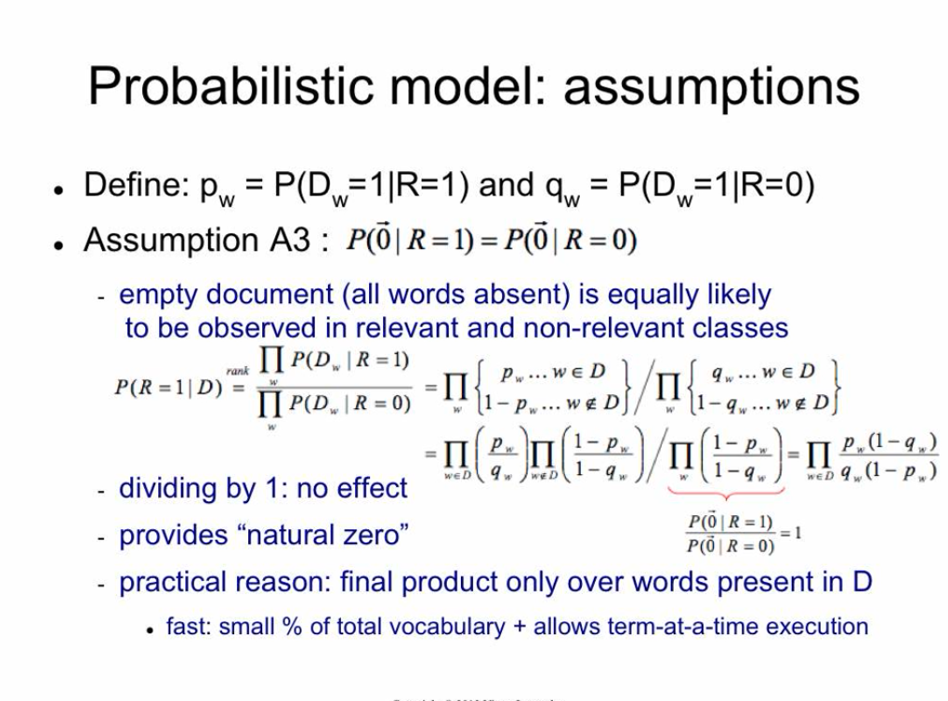

Slide 49
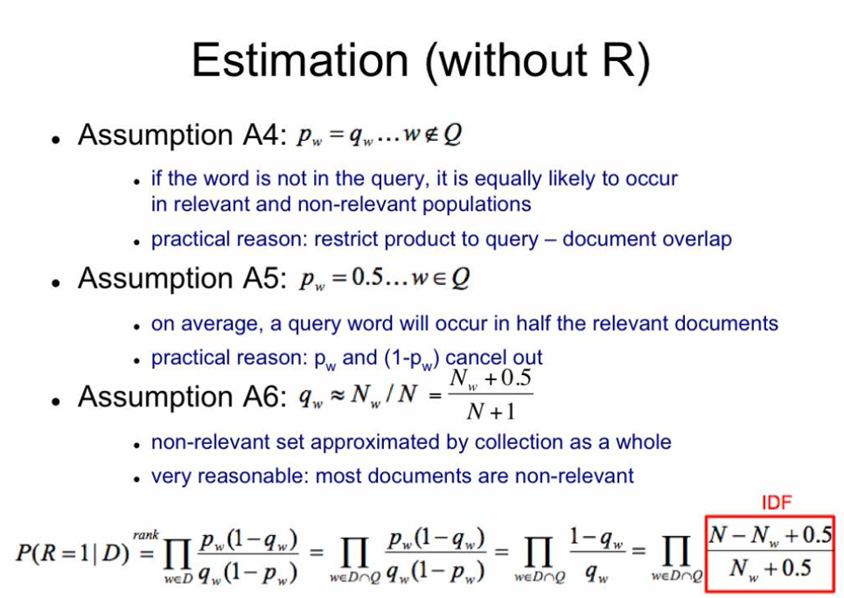

Slide 50
Language models for information retrieval

Slide 51
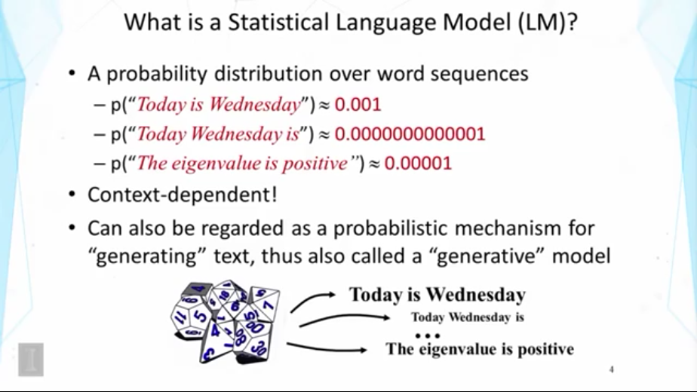

Slide 52
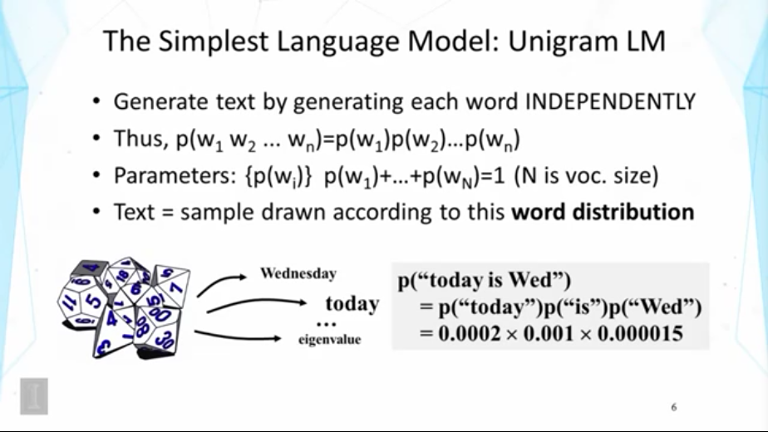

Slide 53
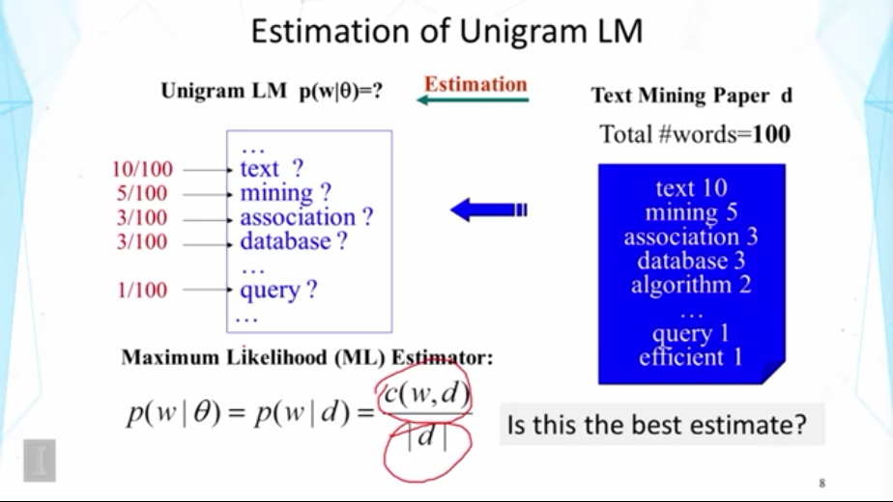

Slide 54
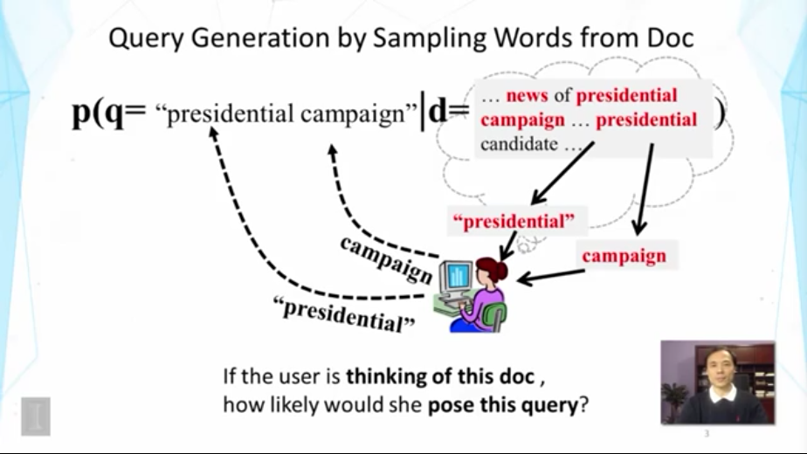

Slide 55
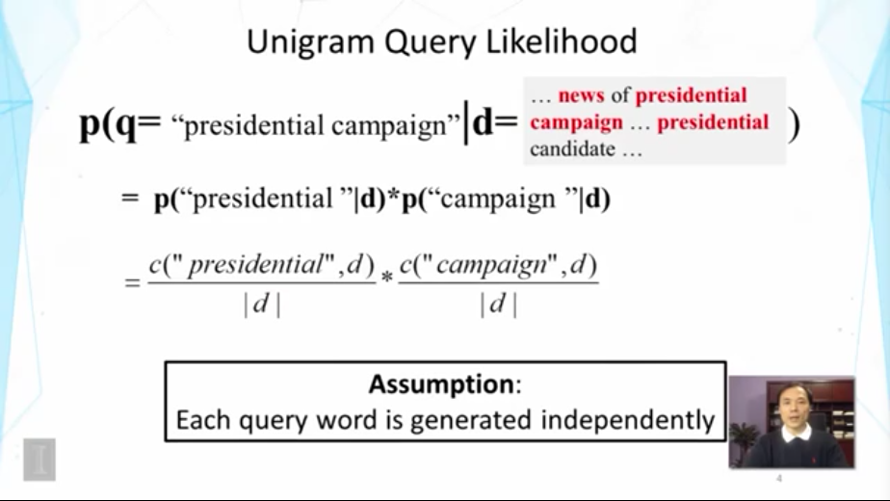

Slide 56
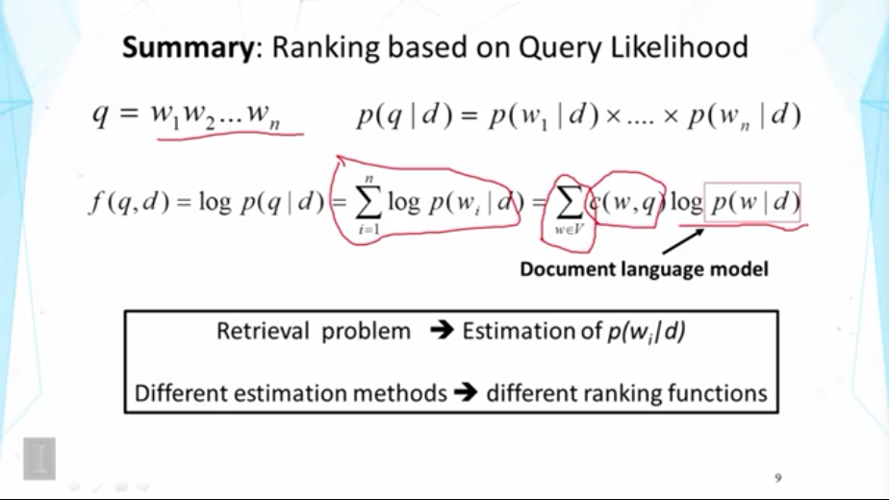

Slide 57
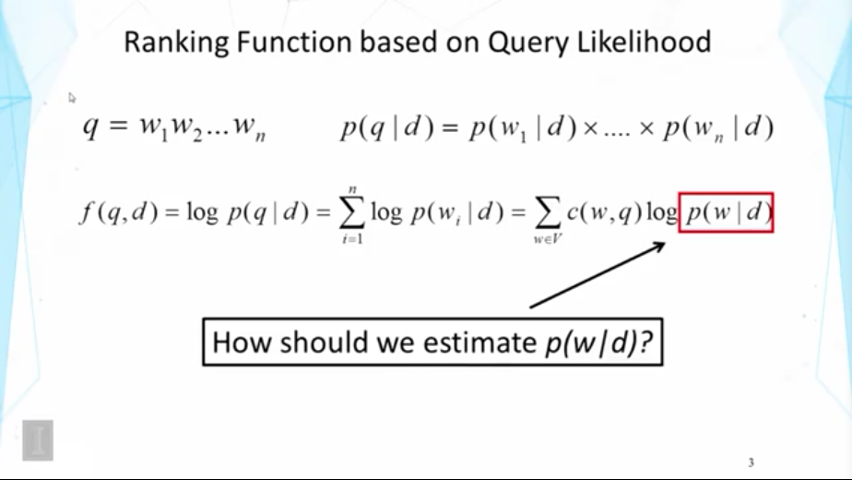

Slide 58
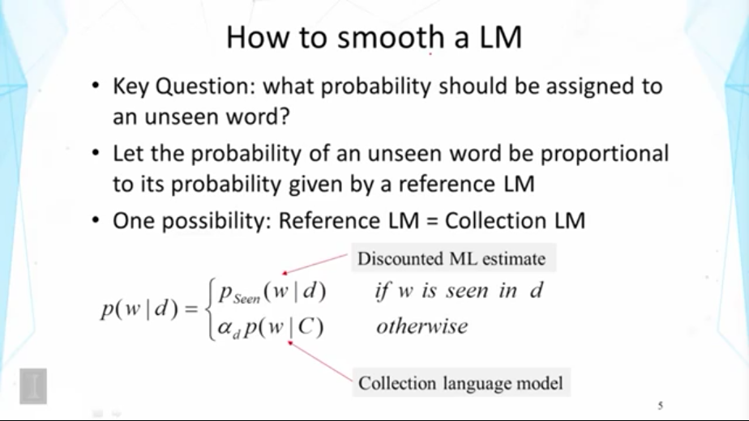

Slide 59
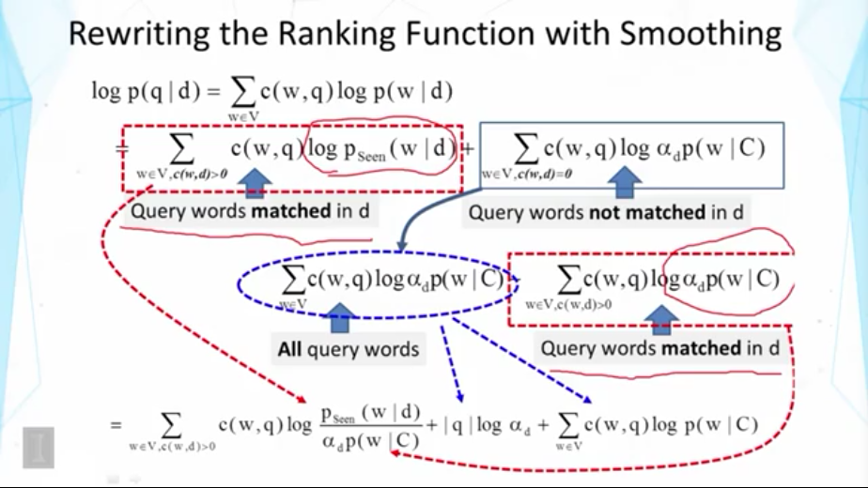

Slide 60
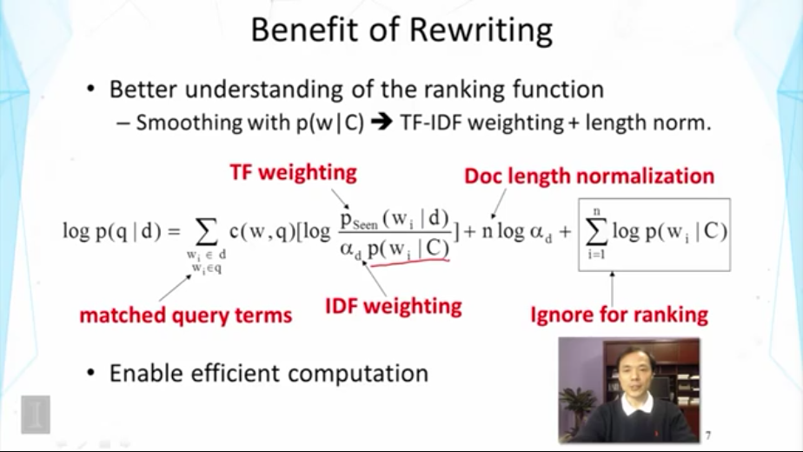

Slide 61
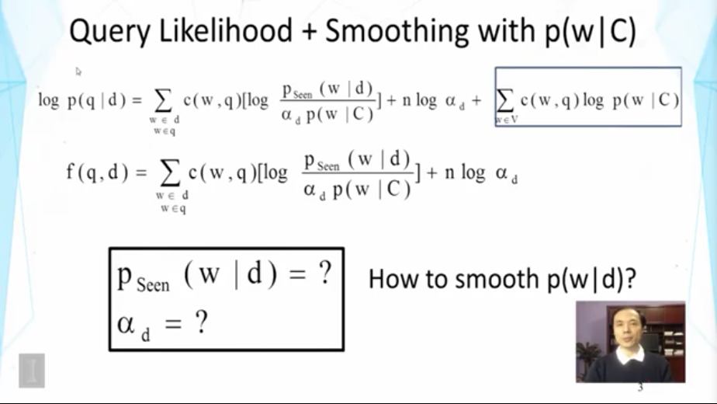

Slide 62
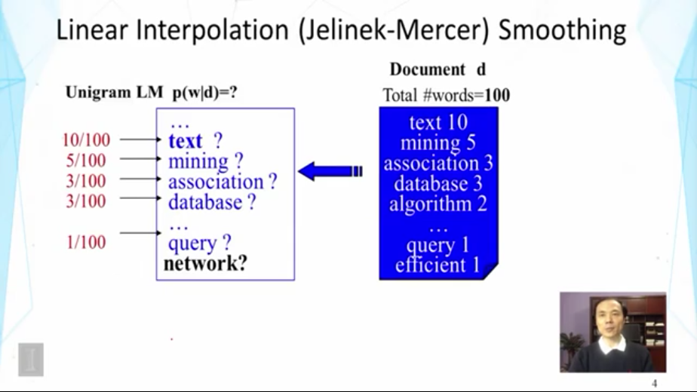

Slide 63
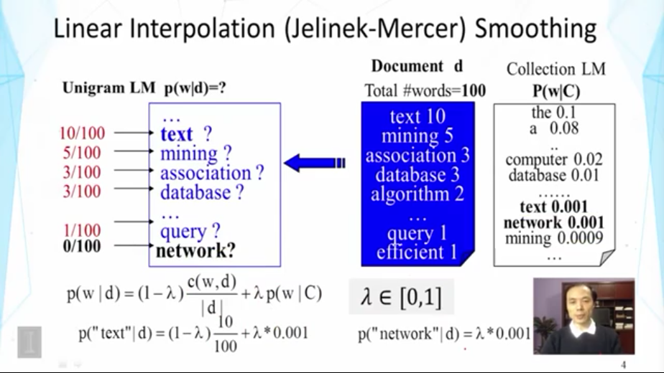

Slide 64
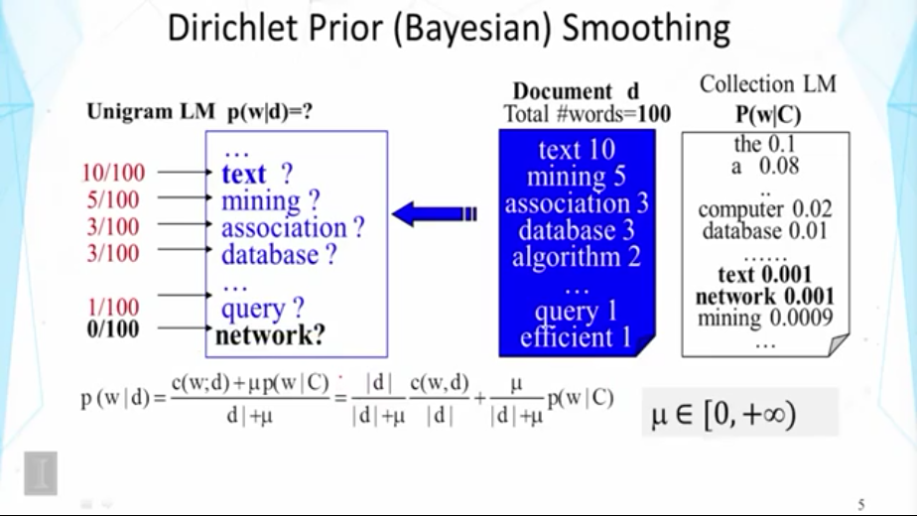
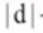

Slide 65


Slide 66
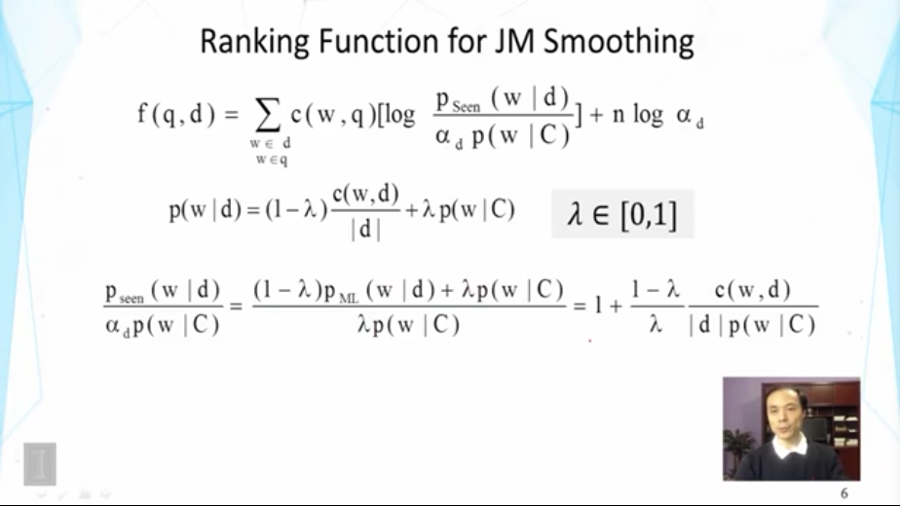

Slide 67
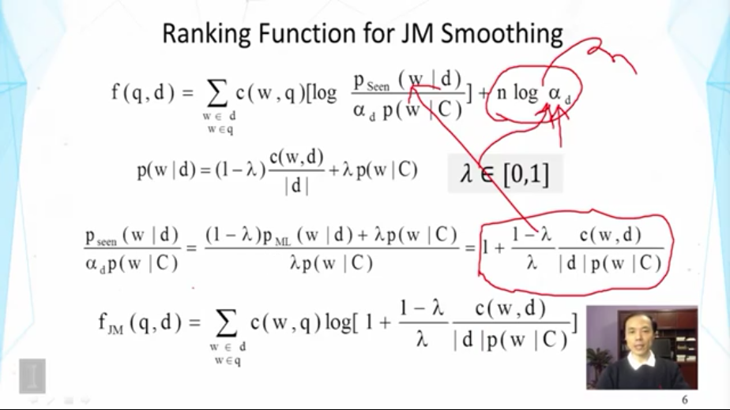

Slide 68
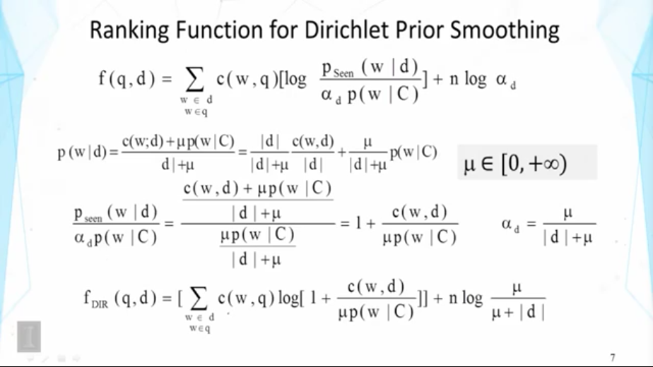

Slide 69
Feedback

Slide 70


Slide 71


Slide 72


Slide 73


Slide 74


Slide 75


Slide 76


Slide 77


Slide 78


Slide 79


Slide 80
Link Analysis

Slide 81
Links as Votes
Idea: Links as votes
Page is more important if it has more links
In-coming links? Out-going links?
Think of in-links as votes:
www.stanford.edu has 23,400 in-links
www.joe-schmoe.com has 1 in-link
Are all in-links are equal?
Links from important pages count more
Recursive question!

Slide 82
Example: PageRank Scores
B
38.4
C
34.3
A
3.3
D
3.9
E
8.1
F
3.9
1.6
1.6
1.6
1.6
1.6

Slide 83
Simple Recursive Formulation
Each link’s vote is proportional to the importance of its source page
If page j with importance r_{j} has n out-links, each link gets r_{j} / n votes
Page j’s own importance is the sum of the votes on its in-links
i
k
r_{i}/3
r_{k}/4
j
r_{j}/3
r_{j} = r_{i}/3+r_{k}/4
r_{j}/3
r_{j}/3

Slide 84

PageRank: The “Flow” Model
A “vote” from an important page is worth more
A page is important if it is pointed to by other important pages
Define a “rank” r_{j} for page j
y/2
y
a/2
y/2
m
a
m
a/2
“Flow” equations:
r_{y} = r_{y} /2 + r_{a} /2
r_{a} = r_{y} /2 + r_{m}
r_{m} = r_{a} /2
$d_{i}$ … out-degree of node $i$

Slide 85
Solving the Flow Equations
Flow equations:
3 equations, 3 unknowns, no constants
No unique solution
All solutions equivalent modulo the scale factor
Additional constraint forces uniqueness:
$r_{y} +r_{a}+ r_{m} = 1$
Solution: $r_{y} =\frac{2}{5}, r_{a} =\frac{2}{5}, r_{m} =\frac{1}{5}$
Gaussian elimination method works for small examples, but we need a better method for large web-size graphs
We need a new formulation!
r_{y} = r_{y} /2 + r_{a} /2
r_{a} = r_{y} /2 + r_{m}
r_{m} = r_{a} /2

Slide 86

Example: Flow Equations & M
 | y | a | m
y | ½ | ½ | 0
a | ½ | 0 | 1
m | 0 | ½ | 0
y
a
m
If $i →j$, then $Mji =\frac{1}{di}$ else $Mji = 0$
r = M∙r
r_{y} = r_{y} /2 + r_{a} /2
r_{a} = r_{y} /2 + r_{m}
r_{m} = r_{a} /2
y ½ ½ 0 y
a = ½ 0 1 a
m 0 ½ 0 m

Slide 87

PageRank: Matrix Formulation
Stochastic adjacency matrix $M$
Let page $i$ has $di$ out-links
If $i →j$, then $Mji =\frac{1}{di}$ else $Mji = 0$
$M$ is a column stochastic matrix
Columns sum to 1
Rank vector $r$: vector with an entry per page
$ri$ is the importance score of page $i$
$\sum_{i}{r_{i}^{}=1}$
The flow equations can be written $r = M⋅ r$
Flow equations:
r_{y} = r_{y} /2 + r_{a} /2
r_{a} = r_{y} /2 + r_{m}
r_{m} = r_{a} /2

Slide 88
Example
Remember the flow equation:
Flow equation in the matrix form
$$M⋅ r=r$$
Suppose page i links to 3 pages, including j
i
j
r_{j}
.
=
r_{i}
1/3
M
.
r
=
r

Slide 89


Eigenvector Formulation
The flow equations can be written $r = M ∙ r$
So the rank vector r is an eigenvector of the stochastic web matrix M
In fact, it’s the first or principal eigenvector, with corresponding eigenvalue 1
Largest eigenvalue of M is 1 since M is column stochastic (with non-negative entries)
We can now efficiently solve for r! The method is called Power iteration
NOTE: x is an eigenvector with the corresponding eigenvalue λ if: $$Ax=λx$$

Slide 90
Power Iteration Method
Given a web graph with N nodes, where the nodes are pages and edges are hyperlinks
Power iteration: a simple iterative scheme
Suppose there are N web pages
Initialize: r⁽⁰⁾ = [1/N,….,1/N]^{T}
Iterate: r^{(t+1)} = M ∙ r^{(t)}
Stop when |r^{(t+1)} – r^{(t)}|₁ < ε
d_{i} …. out-degree of node i
|x|₁ = ∑_{1≤i≤N}|x_{i}| is the L1 norm
Can use any other vector norm, e.g., Euclidean

Slide 91

PageRank: How to solve?
Power Iteration:
Set $r_{j}=1$/N
1: ${r′}_{j}=\sum_{i→j}{\frac{r_{i}}{d_{i}}}$
2:$r=r′$
Goto 1
Example:
r_{y} 1/3 1/3 5/12 9/24 6/15
r_{a} = 1/3 3/6 1/3 11/24 … 6/15
r_{m} 1/3 1/6 3/12 1/6 3/15
y
 | y | a | m
y | ½ | ½ | 0
a | ½ | 0 | 1
m | 0 | ½ | 0
a
m
r_{y} = r_{y} /2 + r_{a} /2
r_{a} = r_{y} /2 + r_{m}
r_{m} = r_{a} /2
Iteration 0, 1, 2, …

Slide 92
PageRank: How to solve?
Power Iteration:
Set $r_{j}=1$/N
1: ${r′}_{j}=\sum_{i→j}{\frac{r_{i}}{d_{i}}}$
2:$r=r′$
Goto 1
Example:
r_{y} 1/3 1/3 5/12 9/24 6/15
r_{a} = 1/3 3/6 1/3 11/24 … 6/15
r_{m} 1/3 1/6 3/12 1/6 3/15
y
 | y | a | m
y | ½ | ½ | 0
a | ½ | 0 | 1
m | 0 | ½ | 0
a
m
r_{y} = r_{y} /2 + r_{a} /2
r_{a} = r_{y} /2 + r_{m}
r_{m} = r_{a} /2
Iteration 0, 1, 2, …

Slide 93

Random Walk Interpretation
Imagine a random web surfer:
At any time $t$, surfer is on some page $i$
At time $t+1$, the surfer follows an out-link from $i$ uniformly at random
Ends up on some page $j$ linked from $i$
Process repeats indefinitely
Let:
$p(t)$ … vector whose $i$^{th} coordinate is the prob. that the surfer is at page $i$ at time $t$
So, $p(t)$ is a probability distribution over pages
i₁
i₂
i₃
j

Slide 94

The Stationary Distribution
i₁
i₂
i₃
Where is the surfer at time t+1?
Follows a link uniformly at random
$p\left(t+1\right)= M⋅p(t)$
Suppose the random walk reaches a state $p\left(t+1\right)= M⋅p(t) = p(t)$
then $p(t)$ is stationary distribution of a random walk
Our original rank vector $r$ satisfies $r = M⋅r$
So, $r$ is a stationary distribution for the random walk
j

Slide 95
Existence and Uniqueness
A central result from the theory of random walks (a.k.a. Markov processes):
For graphs that satisfy certain conditions, the stationary distribution is unique and eventually will be reached no matter what the initial probability distribution at time t = 0

Slide 96
PageRank: The Google Formulation

Slide 97
PageRank: Three Questions
Does this converge?
Does it converge to what we want?
Are results reasonable?
or
equivalently

Slide 98
Does this converge?
Example:
r_{a} 1 0 1 0
r_{b} 0 1 0 1
a
b
=
Iteration 0, 1, 2, …

Slide 99
Does it converge to what we want?
Example:
r_{a} 1 0 0 0
r_{b} 0 1 0 0
a
b
=
Iteration 0, 1, 2, …

Slide 100
PageRank: Problems
Dead end
Two problems:
(1) Some pages are dead ends (have no out-links)
Random walk has “nowhere” to go to
Such pages cause importance to “leak out”
(2) Spider traps: (all out-links are within the group)
Random walked gets “stuck” in a trap
And eventually spider traps absorb all importance
Spider trap

Slide 101

Problem: Spider Traps
Power Iteration:
Set $r_{j}=1$
$r_{j}=\sum_{i→j}{\frac{r_{i}}{d_{i}}}$
And iterate
Example:
r_{y} 1/3 2/6 3/12 5/24 0
r_{a} = 1/3 1/6 2/12 3/24 … 0
r_{m} 1/3 3/6 7/12 16/24 1
y
 | y | a | m
y | ½ | ½ | 0
a | ½ | 0 | 0
m | 0 | ½ | 1
a
m
m is a spider trap
r_{y} = r_{y} /2 + r_{a} /2
r_{a} = r_{y} /2
r_{m} = r_{a} /2 + r_{m}
Iteration 0, 1, 2, …
All the PageRank score gets “trapped” in node m.

Slide 102
Solution: Teleports!
The Google solution for spider traps: At each time step, the random surfer has two options
With prob. β, follow a link at random
With prob. 1-β, jump to some random page
Common values for β are in the range 0.8 to 0.9
Surfer will teleport out of spider trap within a few time steps
y
y
a
m
a
m
Notes:
Teleports 远程传送

Slide 103

Problem: Dead Ends
Power Iteration:
Set $r_{j}=1$
$r_{j}=\sum_{i→j}{\frac{r_{i}}{d_{i}}}$
And iterate
Example:
r_{y} 1/3 2/6 3/12 5/24 0
r_{a} = 1/3 1/6 2/12 3/24 … 0
r_{m} 1/3 1/6 1/12 2/24 0
y
 | y | a | m
y | ½ | ½ | 0
a | ½ | 0 | 0
m | 0 | ½ | 0
a
m
r_{y} = r_{y} /2 + r_{a} /2
r_{a} = r_{y} /2
r_{m} = r_{a} /2
Iteration 0, 1, 2, …
Here the PageRank “leaks” out since the matrix is not stochastic.

Slide 104
Solution: Always Teleport!
Teleports: Follow random teleport links with probability 1.0 from dead-ends
Adjust matrix accordingly
y
y
a
m
a
m
 | y | a | m
y | ½ | ½ | 0
a | ½ | 0 | 0
m | 0 | ½ | 0
 | y | a | m
y | ½ | ½ | ⅓
a | ½ | 0 | ⅓
m | 0 | ½ | ⅓

Slide 105
Why Teleports Solve the Problem?
Why are dead-ends and spider traps a problem and why do teleports solve the problem?
Spider-traps are not a problem, but with traps PageRank scores are not what we want
Solution: Never get stuck in a spider trap by teleporting out of it in a finite number of steps
Dead-ends are a problem
The matrix is not column stochastic so our initial assumptions are not met
Solution: Make matrix column stochastic by always teleporting when there is nowhere else to go

Slide 106


Solution: Random Teleports
Google’s solution that does it all: At each step, random surfer has two options:
With probability β, follow a link at random
With probability 1-β, jump to some random page
PageRank equation [Brin-Page, 98] $r_{j}=\sum_{i→j}{β \frac{r_{i}}{d_{i}}}+(1−β)\frac{1}{N}$
d_{i} … out-degree of node i
This formulation assumes that $M$ has no dead ends. We can either preprocess matrix $M$ to remove all dead ends or explicitly follow random teleport links with probability 1.0 from dead-ends.

Slide 107

The Google Matrix
PageRank equation [Brin-Page, ‘98] $r_{j}=\sum_{i→j}{β\frac{r_{i}}{d_{i}}}+(1−β)\frac{1}{N}$
The Google Matrix A:
$$A=β M+\left(1−β\right){\left[\frac{1}{N}\right]}_{N×N}$$
We have a recursive problem: $r=A⋅r$ And the Power method still works!
What is β ?
In practice β =0.8,0.9 (make 5 steps on avg., jump)
[1/N]_{NxN}…N by N matrix where all entries are 1/N

Slide 108
Random Teleports (β = 0.8)
M
[1/N]_{NxN}
7/15
y
1/2 1/2 0
1/2 0 0
0 1/2 1
1/3 1/3 1/3
1/3 1/3 1/3
1/3 1/3 1/3
0.8
+ 0.2
7/15
1/15
7/15
1/15
y 7/15 7/15 1/15
a 7/15 1/15 1/15
m 1/15 7/15 13/15
13/15
a
7/15
m
1/15
1/15
A
y
a =
m
1/3
1/3
1/3
0.33
0.20
0.46
0.24
0.20
0.52
0.26
0.18
0.56
7/33
5/33
21/33
. . .

